Slide 1
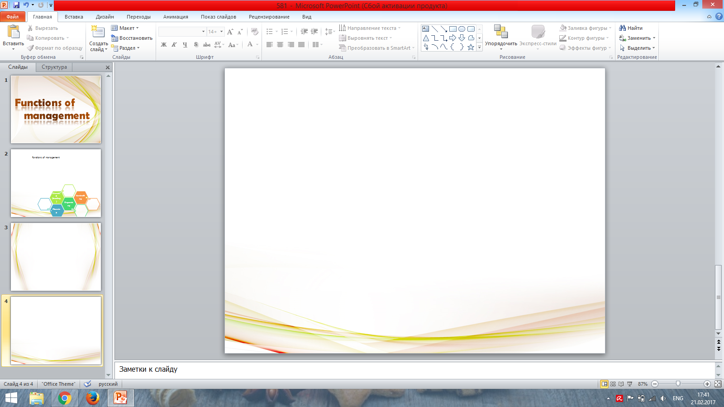
Planning
Organizing
Directing (leading)
Controlling
Motivating
Regulating
Coordinating
Functions
of
management

Slide 2
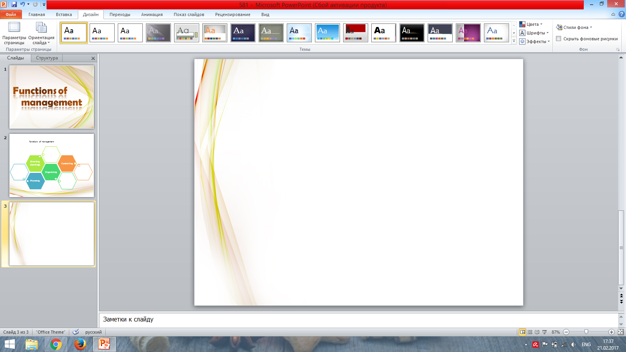
Planning functions
of management
Planning is the function of management that
involve setting objectives and determining a
course of action for achieving these objectives.
Tactical
Operational
Strategic

Slide 3
Organizing functions
of management
Organizing is the function of management that
involves developing an organizational structure and allocating human resources to ensure the accomplishment of objectives.

Slide 4
Directing (leading)
functions of management
Leading involves influencing others toward
the attainment of organizational objectives.
Effective leading requires the manager to
motivate subordinates, communicate
affectively and affectively use power.

Slide 5
Controlling functions
of management
Controlling involves ensuring that performance does not deviate from standards.
Controlling consist of three steps, which
include establishing actual performance
against standards and taking corrective
action when necessary.

Slide 6
Motivating functions
of management
Motivating - is the process of encouraging
workers to high-performance activities to meet their needs and achieve organizational goals.

Slide 7
Coordinating functions
of management
Coordinating as a functions of management is a process aimed at ensuring proportional and
harmonious development of the various parties (industrial, technical, financial.)

Slide 8
Regulating functions
of management
Regulating – a kind of administrative work, the aim of which is to overcome the contradiction between organization and disorganization,
procedures and factors that violate order.

